Slide 1
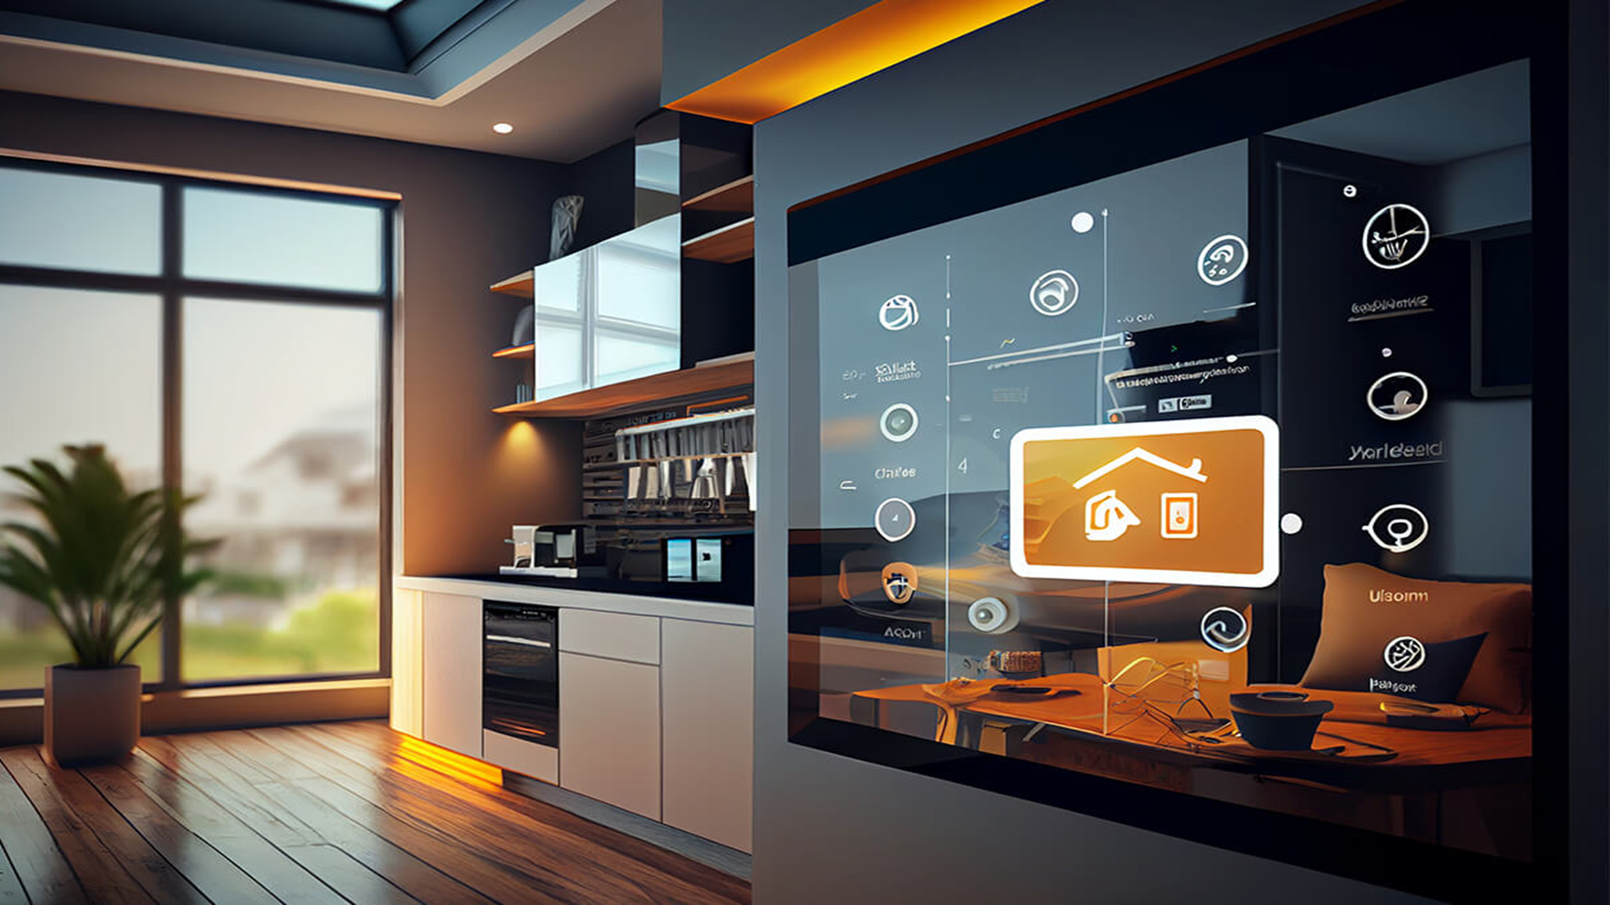
Contents
01 Introduction
02 Key Features
03 Workflow Overview
04 Hardware Components
05 Software Stack
06 Project Workflow
07 Unique Selling Points (USP)
08 Additional Features
09 Future Enhancements
10 Conclusion
LumenHive:
A Smart Home Automation

Slide 2

Contents
06 Project Workflow
07 Unique Selling Points (USP)
08 Additional Features
09 Future Enhancements
10 Conclusion
01 Introduction
02 Key Features
03 Workflow Overview
04 Hardware Components
05 Software Stack

Slide 3
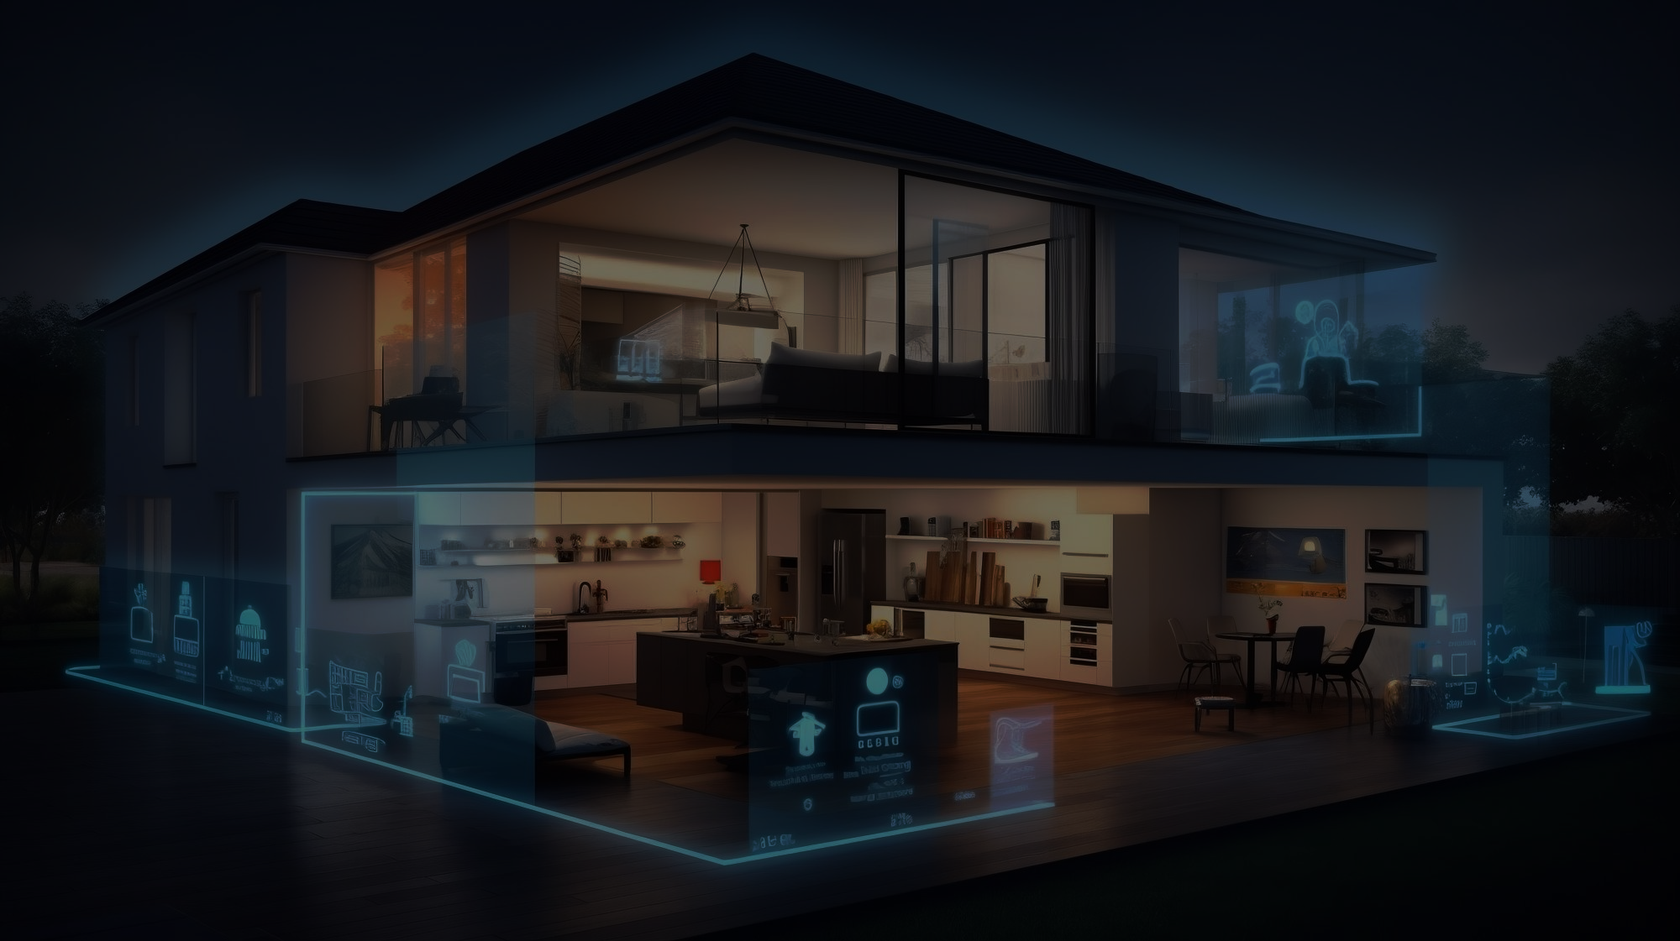











Slide 4

INTRODUCTION

Slide 5
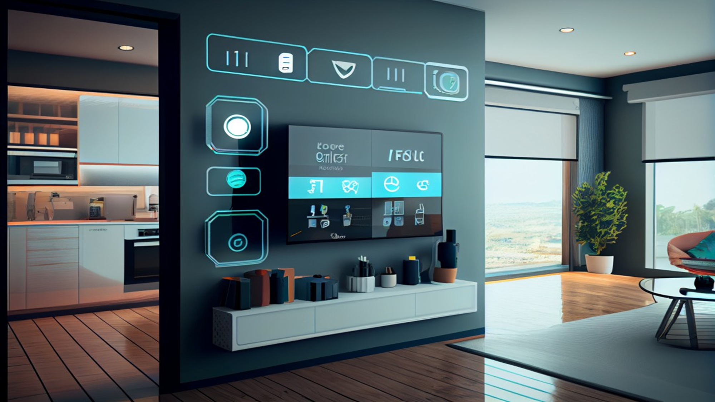
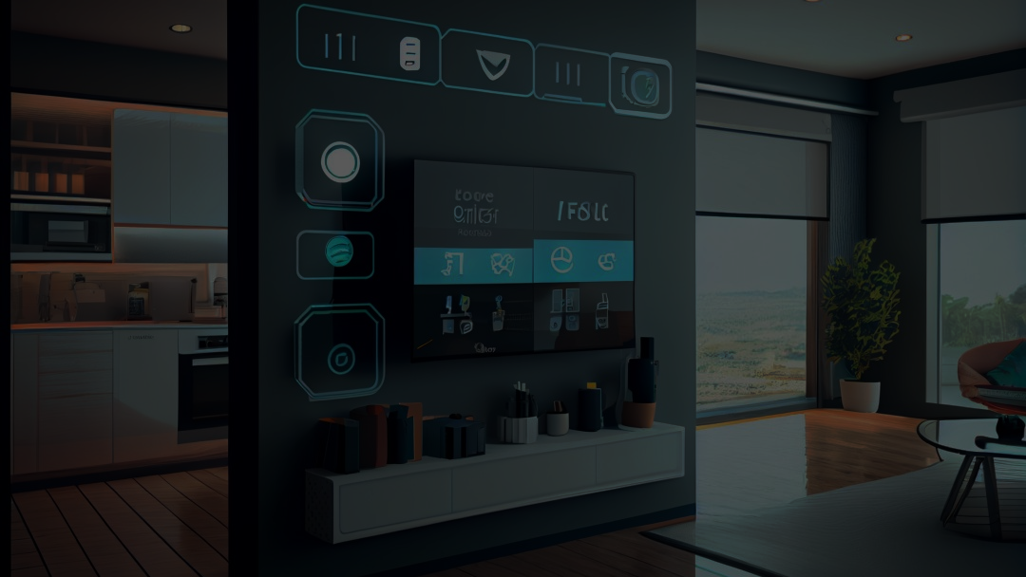
INTRODUCTION
A smart home is a residence with internet-connected devices enabling remote control and automation of household systems.
Managed via smartphones, voice assistants, or central hubs, these technologies improve convenience, security, and energy efficiency. Common smart devices include thermostats, lighting, cameras, locks, and appliances, all working together to create a personalized and automated living experience..

Slide 6
INTRODUCTION
Our project combines AI, IoT, and Home Automation to deliver a seamless user experience by enabling smart devices to communicate and adapt to user preferences. AI analyzes data from IoT sensors, automating tasks like lighting and security. The system continuously learns and optimizes routines, providing personalized, efficient, and intuitive home management.
A smart home is a residence with internet-connected devices enabling remote control and automation of household systems.
Managed via smartphones, voice assistants, or central hubs, these technologies improve convenience, security, and energy efficiency. Common smart devices include thermostats, lighting, cameras, locks, and appliances, all working together to create a personalized and automated living experience..

Slide 7

KEY FEATURES

Slide 8
KEY FEATURES
Facial Recognition at the door.
Voice Recognition and web-based control of devices.
Appliance control via ESP32 and relays.
Security Alert: Capture and send images of unrecognized users.
AI Cooking Assistant: Recipe suggestions and cooking timers.
Offline Functionality for essential operations without WiFi.

Slide 9

WORKFLOW OVERVIEW

Slide 10
SMART RECOGNITION

Slide 11





Case – I :
Fingerprint is taken and checked
Registered user is identified
&
Face is scanned and checked
A person standing in front of a closed door
Door gets unlocked

Slide 12


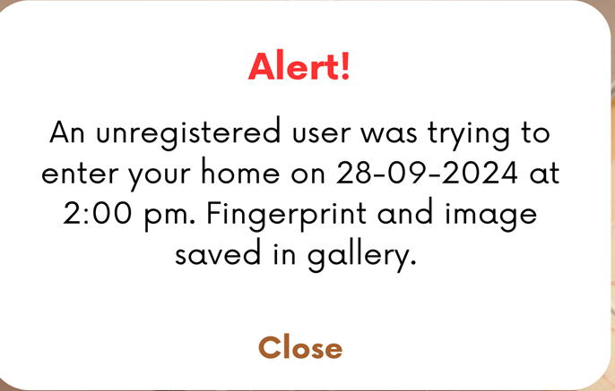
Case – II :
Fingerprint is taken and checked
Unregistered
user
Alert notification sent to registered users
&
Entry not permitted
Face is scanned and checked
A person standing in front of a closed door

Slide 13


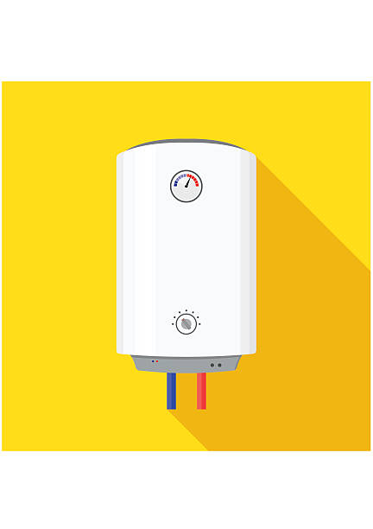



VOICE AUTOMATION

Slide 14
VOICE AUTOMATION

Slide 15

PROJECT
WORKFLOW

Slide 16
PROJECT WORKFLOW
Facial Recognition:
Using a trained AI model to identify users
Voice/Web Control:
ESP32 interacts with voice and web commands to control appliances via relays.
Security Alert:
The system detects an unrecognized user, captures a pic and sends a notification.
AI Assistant:
Interaction with the AI assistant via voice or app for cooking help.
Offline Mode:
Explain how data is logged and synced when the internet reconnects.

Slide 17

SOFTWARE
STACK

Slide 18
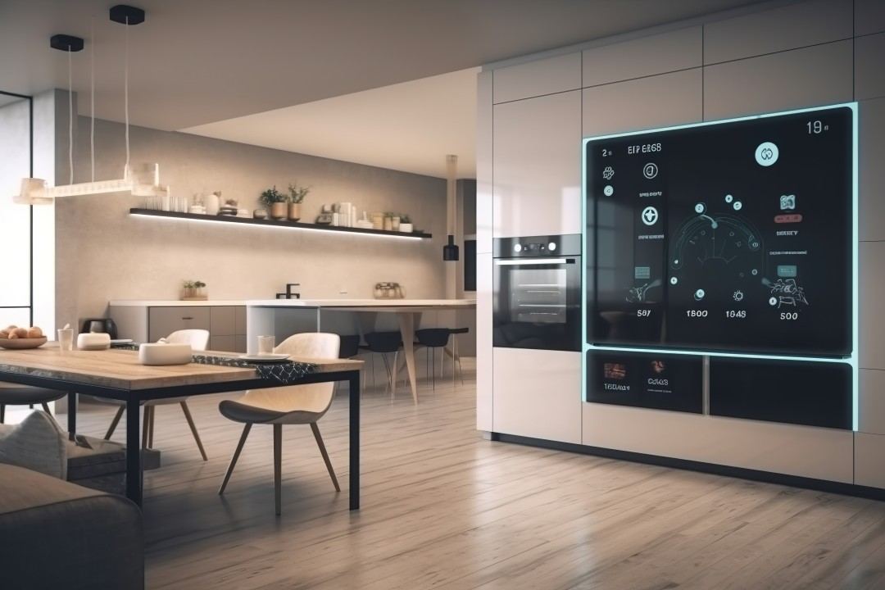
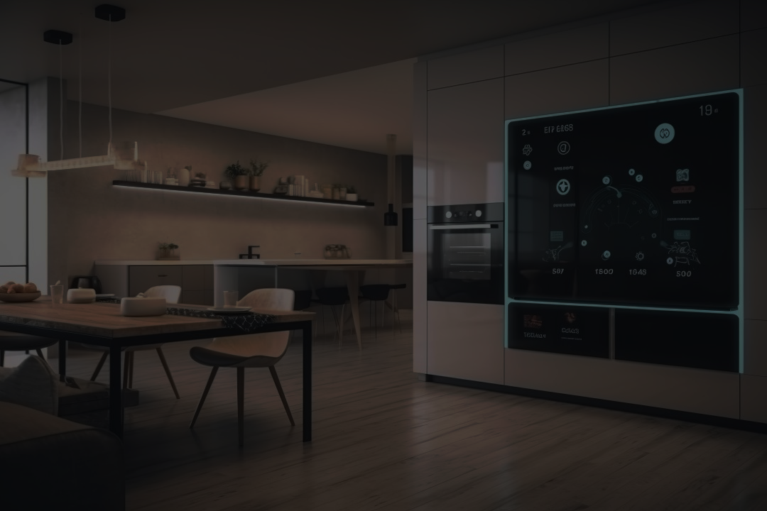
SOFTWARE
STACK
Facial Recognition Model: AI model for recognizing users
Web Application: Used to control devices and view security alerts
Voice Recognition: For issuing commands to the ESP32
AI Cooking Assistant: Recommends recipes and guides through cooking
Cloud Synchronization: Logs data offline and syncs when WiFi is available

Slide 19

HARDWARE COMPONENTS

Slide 20
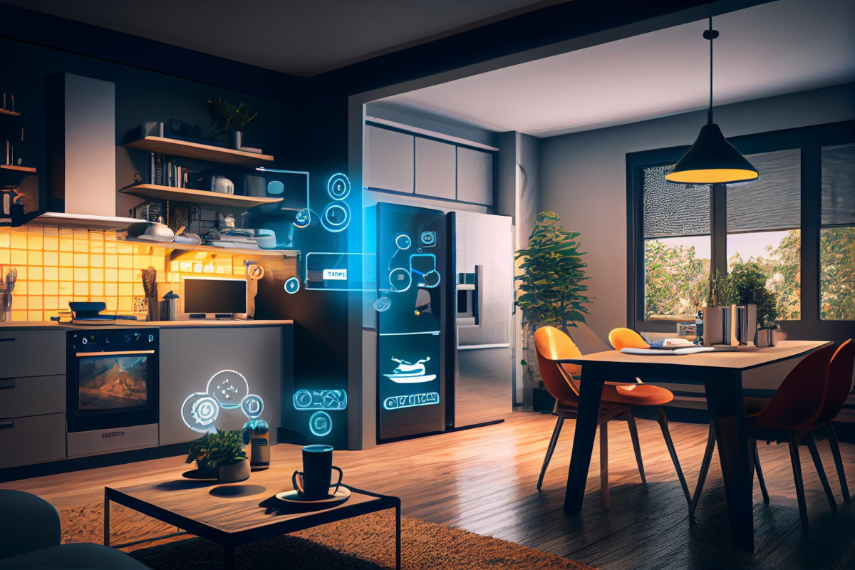

HARDWARE COMPONENTS
ESP32 Microcontroller: Core for automation and IoT connectivity
Relay Module: Controls high-voltage appliances like lights and fans
Camera Module: For facial recognition
Microphone and Speakers: For voice commands and AI assistant
Temperature and Humidity Sensors: For smart climate control
Current Sensors: For energy monitoring.

Slide 21

UNIQUE SELLING POINTS (USP)

Slide 22
UNIQUE SELLING POINTS (USP)
Integrated AI & IoT
AI Cooking Assistant
Security Features
Offline Reliability
Energy Efficiency
Combines AI (facial and voice recognition) with IoT for seamless smart home control.
A standout feature that provides real-time cooking help.
Monitors and alerts on unrecognized entries
Core functions (security, appliance control) work without WiFi.
Optional smart energy usage
monitoring.

Slide 23

ADDITIONAL FEATURES

Slide 24
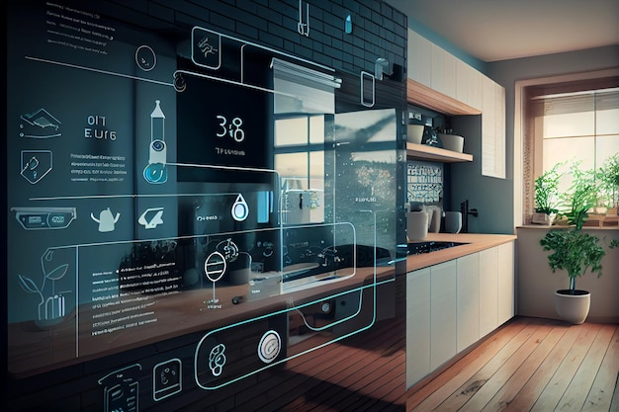


ADDITIONAL FEATURES
Track appliance usage and optimize energy consumption
Mood-based lighting adjustments
Automated temperature and humidity adjustments

Slide 25

FUTURE ENHANCEMENTS

Slide 26
Mobile App
Eco Mode
Blockchain

Slide 27

CONCLUSION
Our project integrates AI, IoT, and Home Automation to create a seamless, secure, and intelligent smart home system. It enhances security with real-time monitoring and facial recognition while offering voice and web-based control for convenience. Scalable and adaptable, the system can easily grow with user needs and support future IoT and AI upgrades. Highly customizable, it fits diverse market demands, from homes to offices.

Slide 28

CONCLUSION
Our project integrates AI, IoT, and Home Automation to create a seamless, secure, and intelligent smart home system. It enhances security with real-time monitoring and facial recognition while offering voice and web-based control for convenience. Scalable and adaptable, the system can easily grow with user needs and support future IoT and AI upgrades. Highly customizable, it fits diverse market demands, from homes to offices.

Slide 29




Meet Our Team…
Rohan
Das
Sayan
Das
Jeet
Sarkar
Sukanya
Bose

